Slide 1


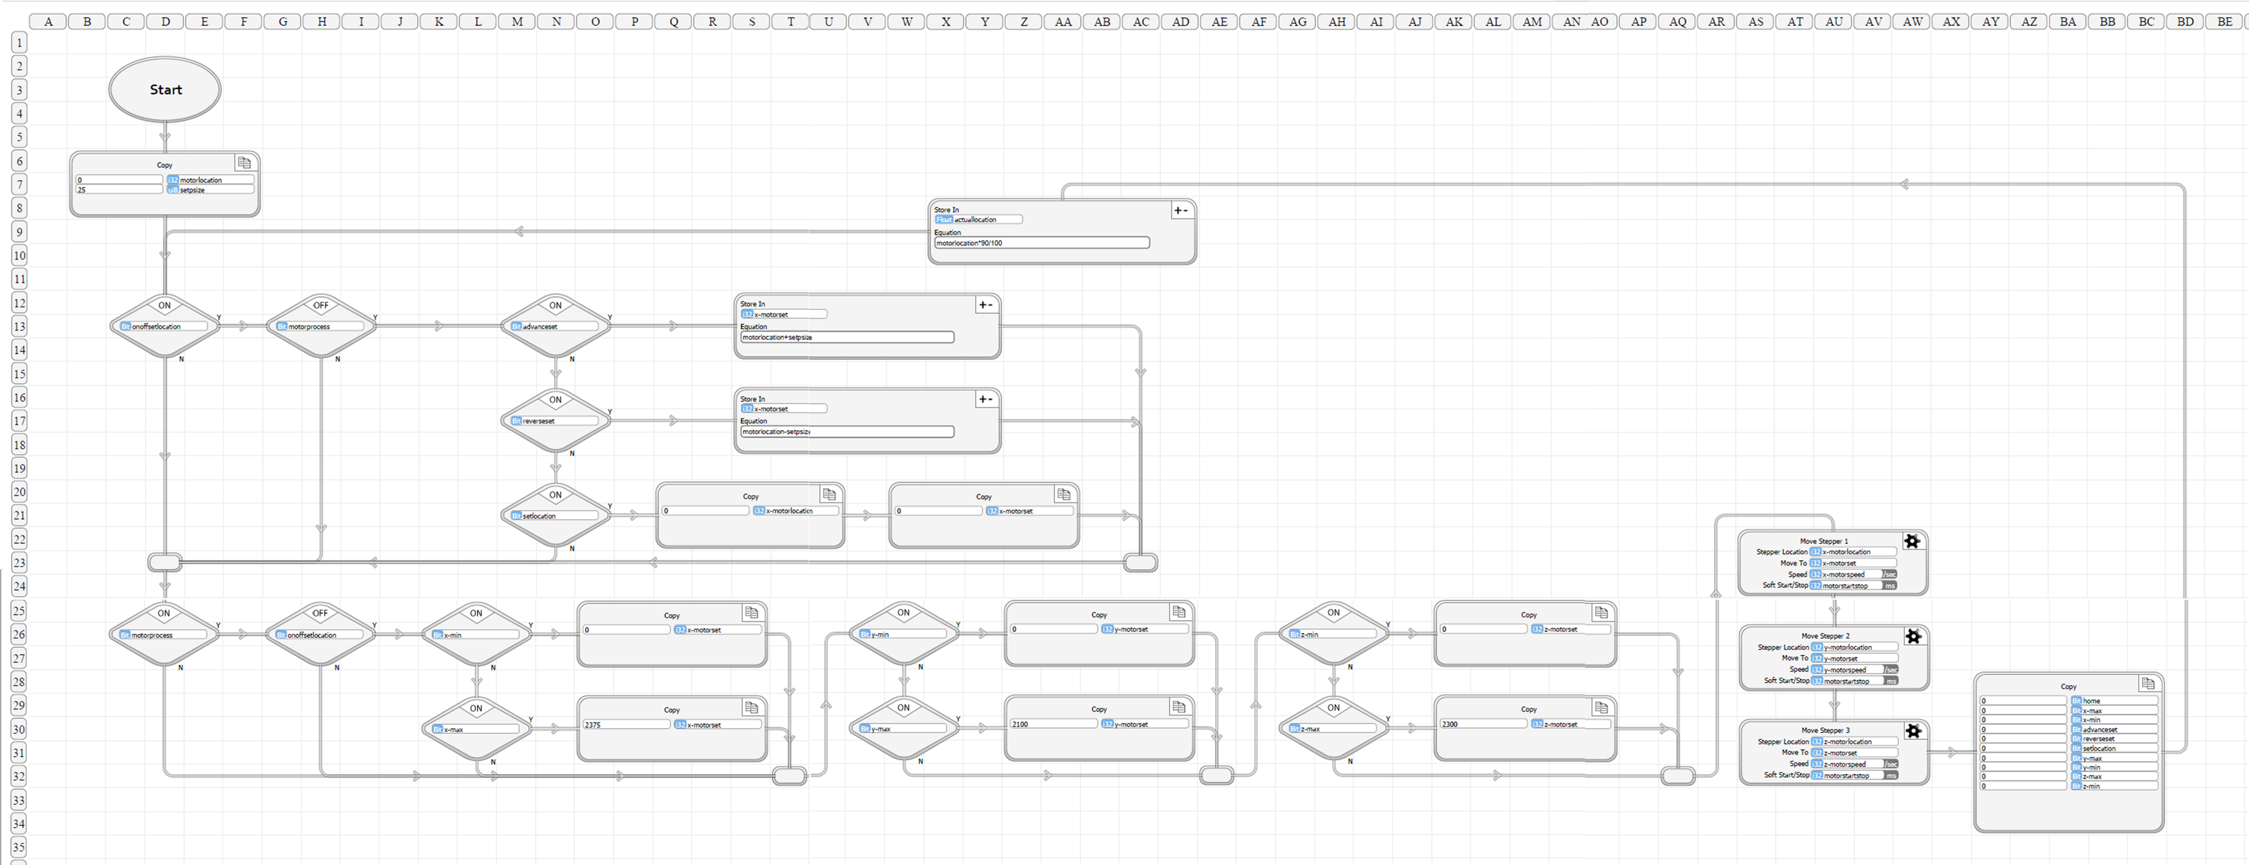
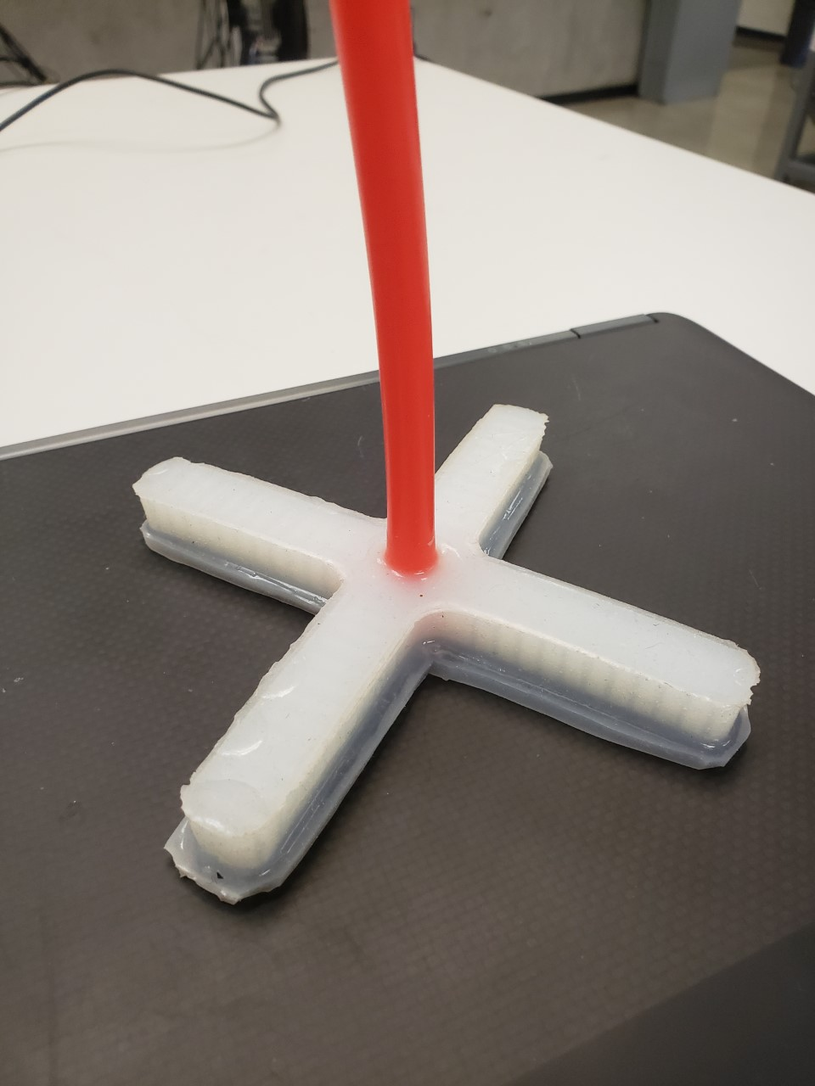
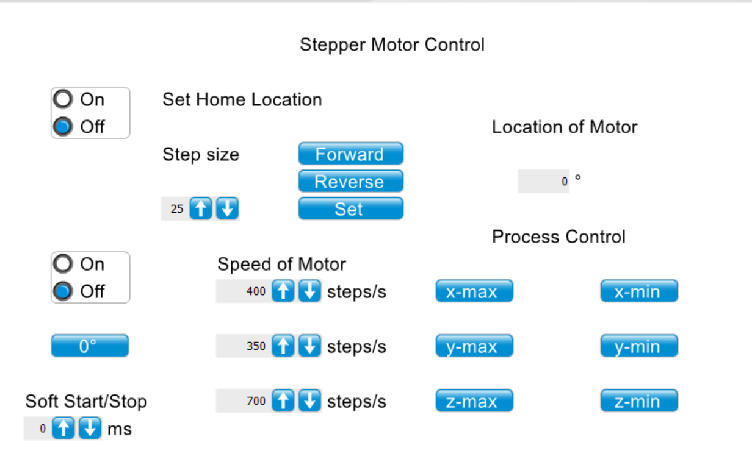

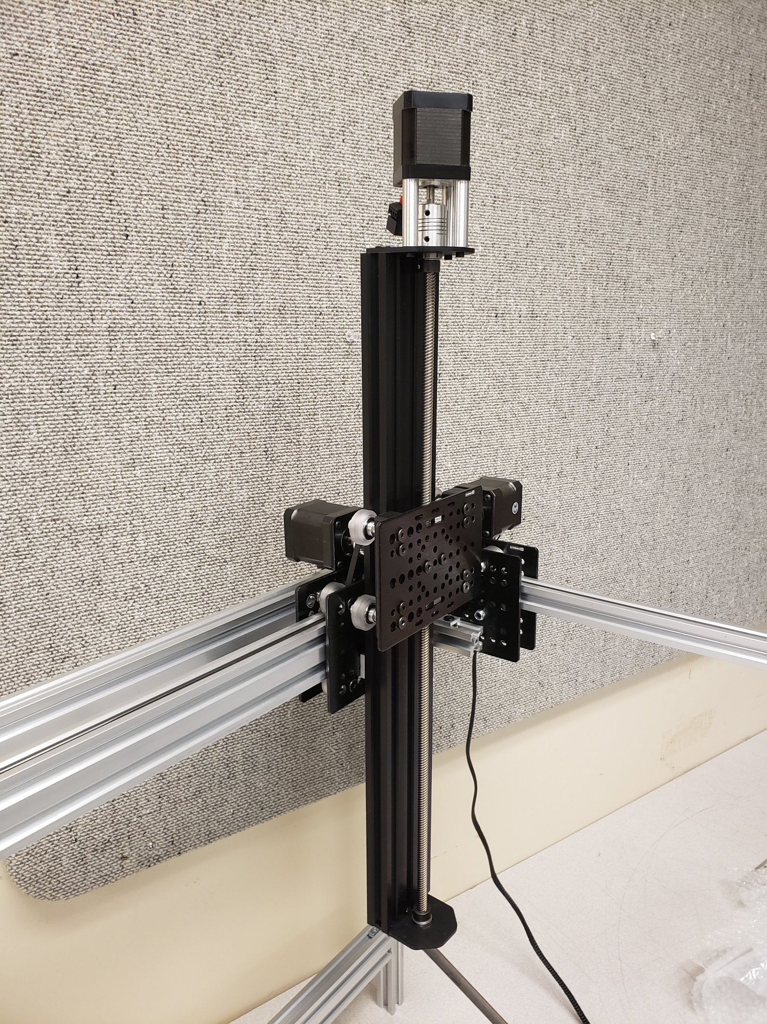
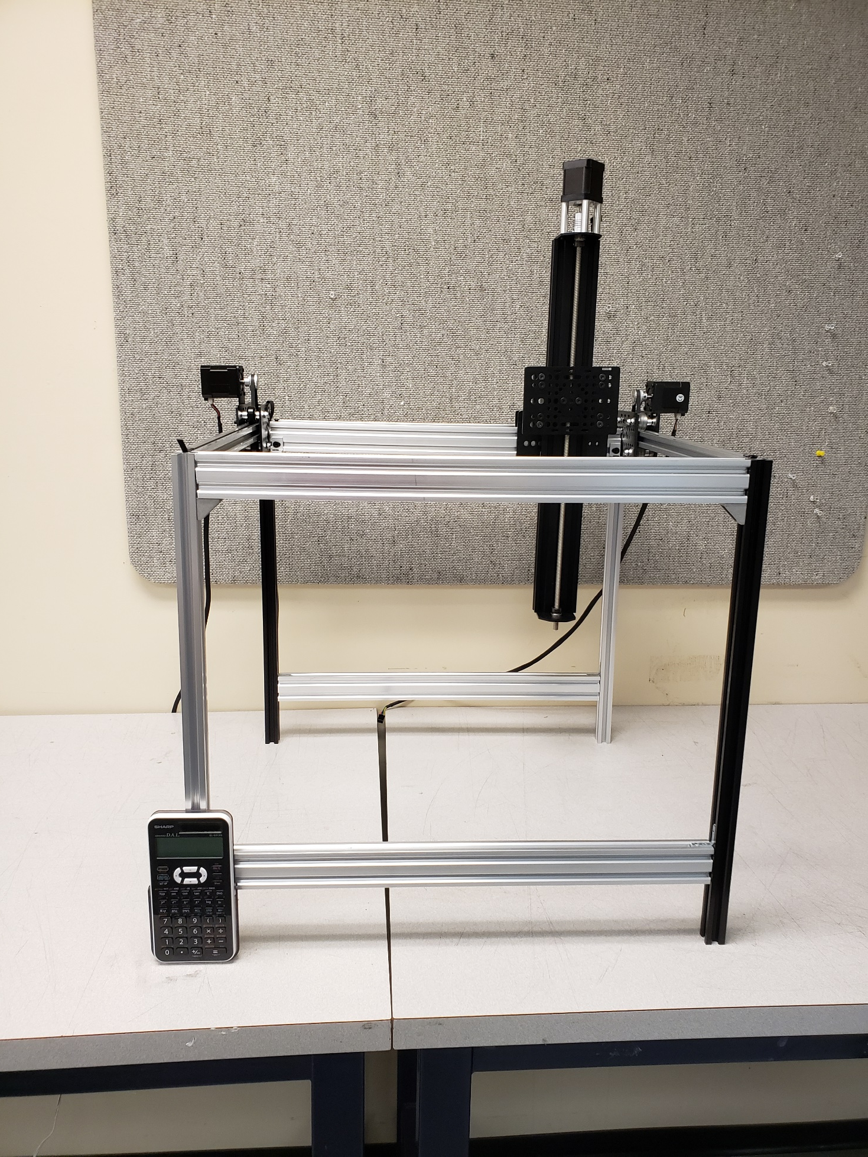
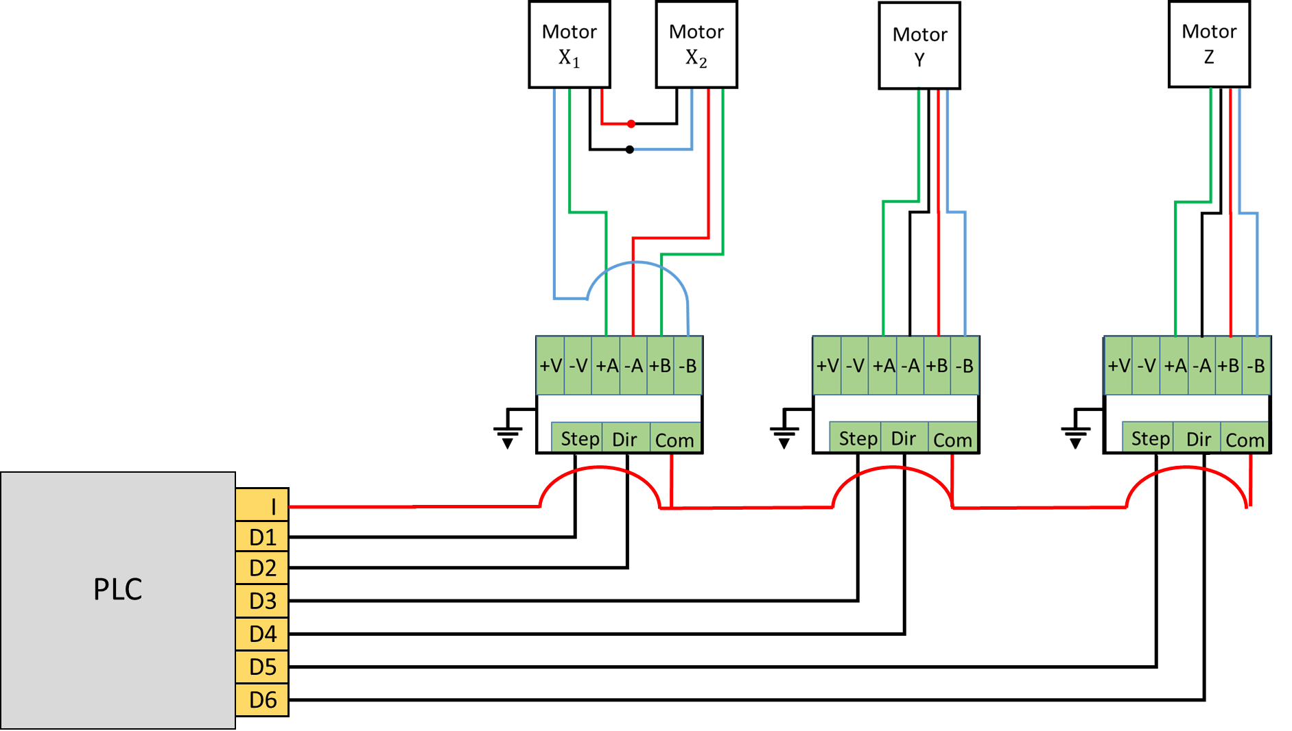
Soft Robotics Actuator
David Camparmo
Department of Physics, Kwantlen Polytechnic University
What is soft Robotics
Flow Based Code
Made using vBuilder
A field of robotics that constructs components of robots out of soft and flexible material
Why Soft Robotics
User interface
The soft bodies of these types of robots have many applications
Surgical assistance
Food preparation industry
Bio mimicry
Exosuits
A screen shot of the user interface that allows the user to control the axes independently
Term Objective
Made using vFactory
To construct the a Cartesian robot that a soft pneumatic actuator can be mounted to
Circuit Diagram
Diagram of the how the motors are wired to the PLC
Next Term Objective
Design and test multiple soft actuators using solid works to design molds for the silicone actuator
PLC

